Slide 1

Amitava Basu
Autism Society West Bengal

Slide 2
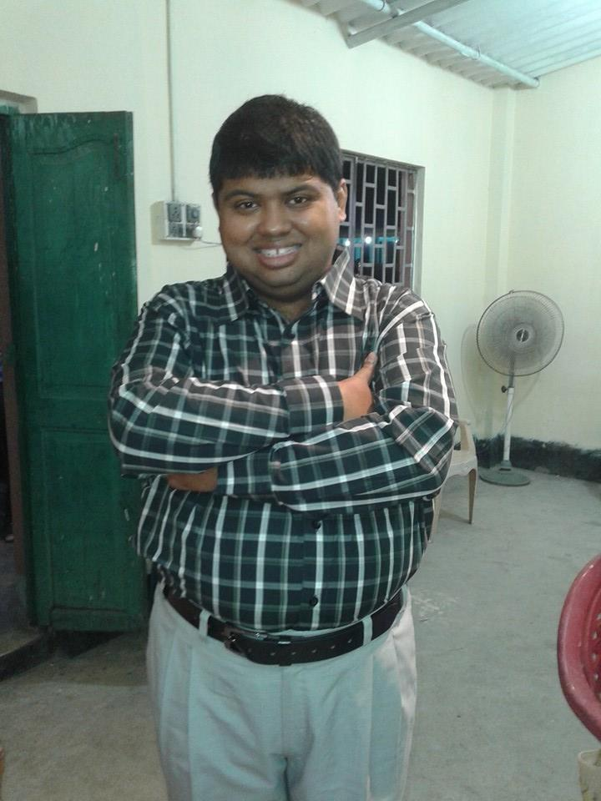
Amitava Basu
Notes:
Good Afternoon Everyone .I am Amitava Basu I work as a classroom assistant and teachers assistant at Autism Society West Bengal .

Slide 3
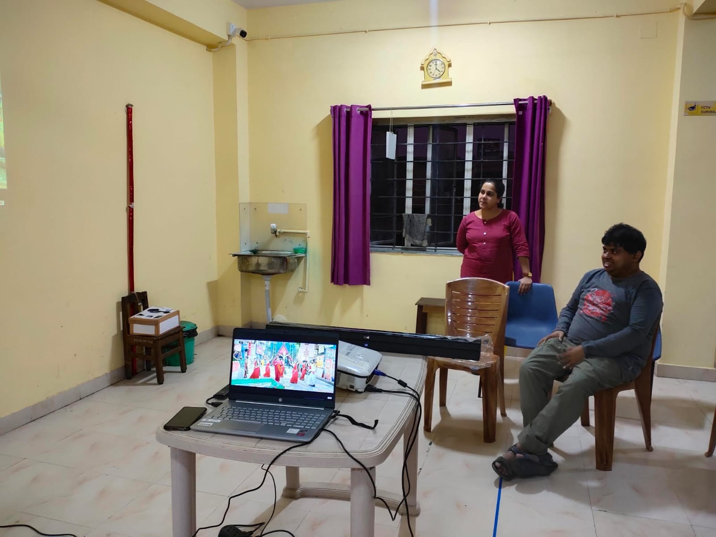
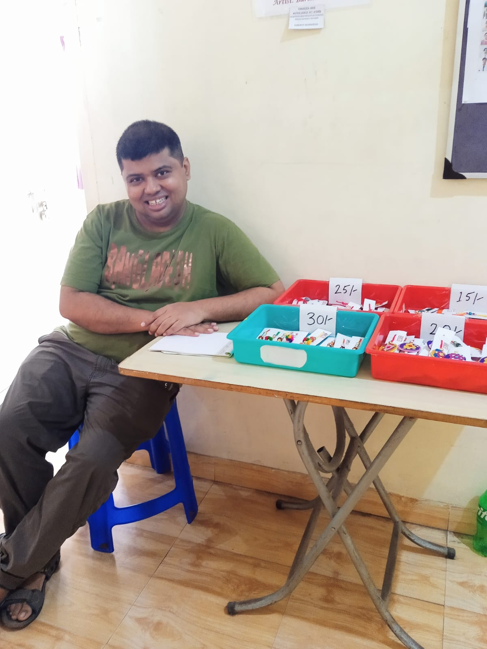
Working as a classroom assistant
Notes:
I help and prepare many of the activities that teachers need while teaching the students at our Dikshan Special School.

Slide 4
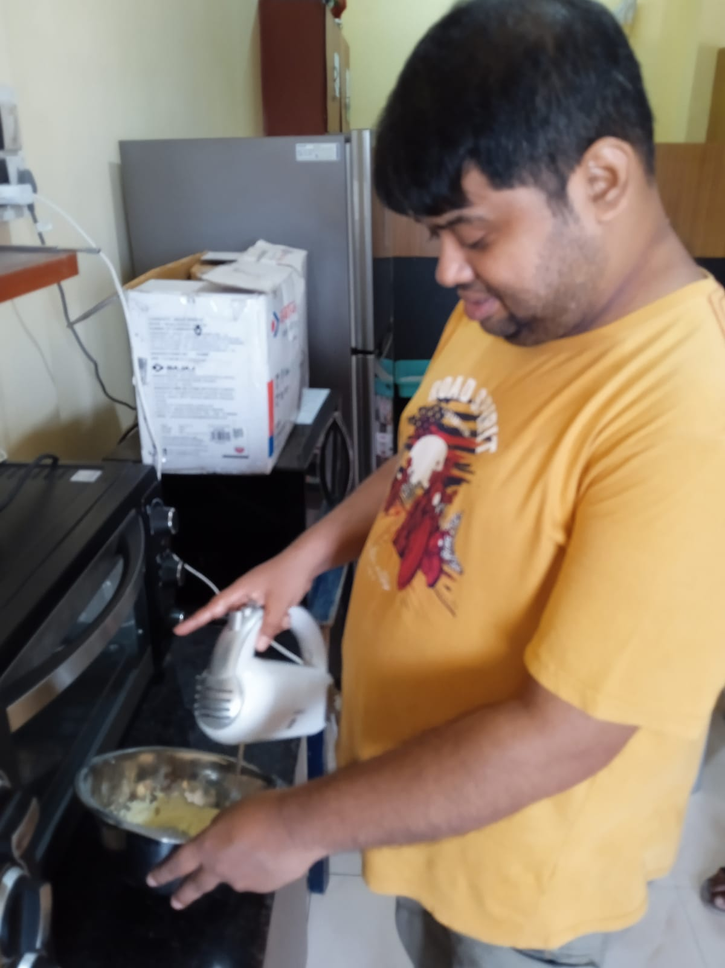
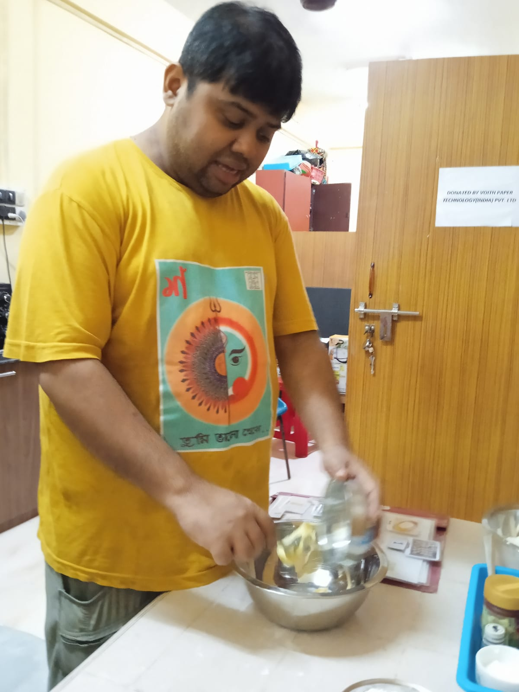
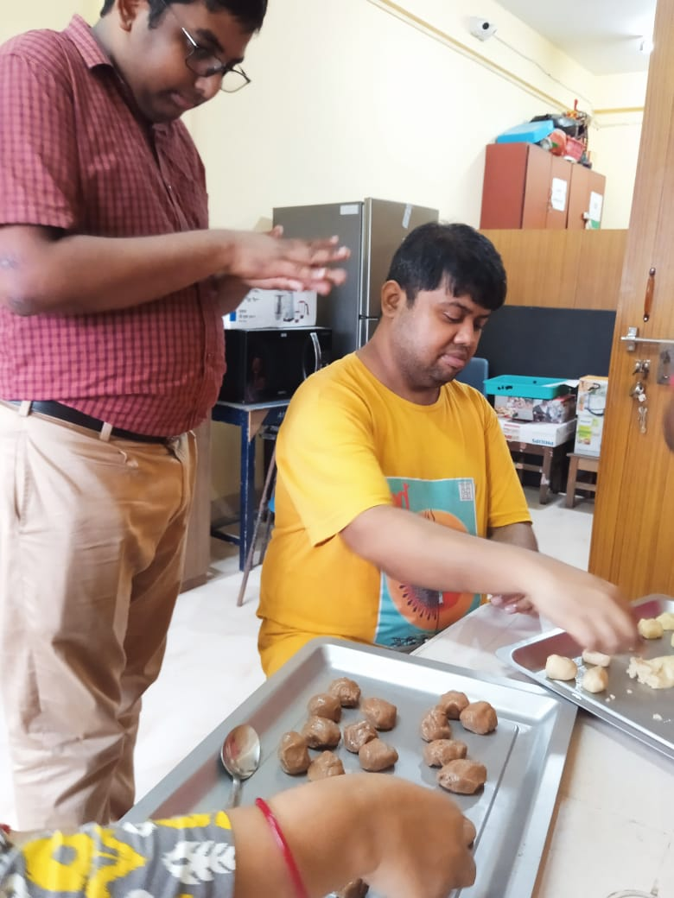
At the Bakery
Notes:
I am learning cookie baking at ASWB . We hope soon we can sell this product to everyone.

Slide 5
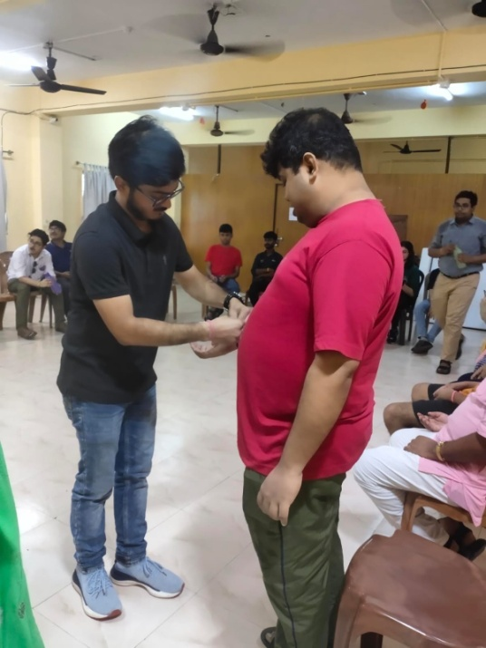
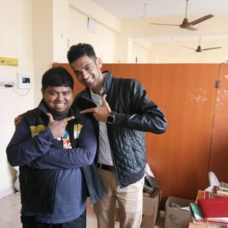
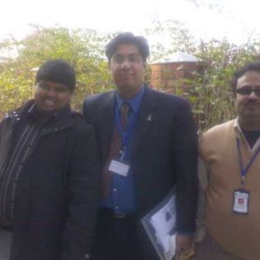
I enjoy meeting people
Notes:
I like many things like watching movies, net searching , listening to music , you tube videos on travel.

Slide 6
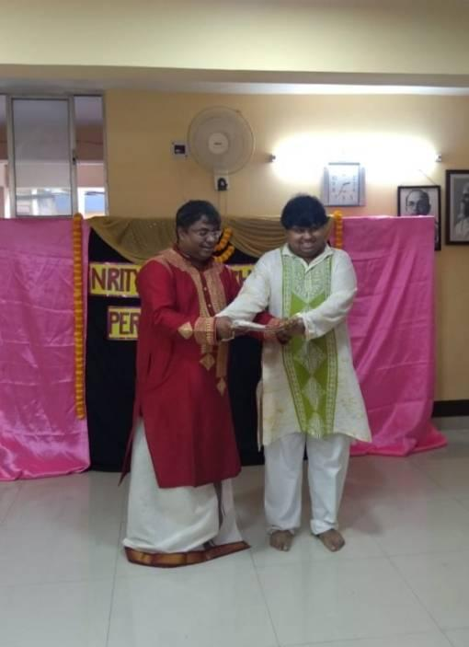
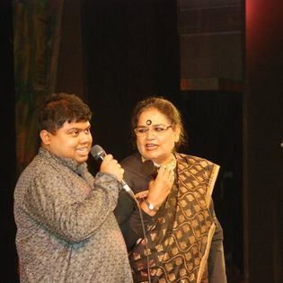
I enjoy singing
Notes:
I also enjoy singing and have learning Rabindra sangeet from my Teacher Judhajeet Roy. I have performed in various programs organized by my teacher and ASWB.

Slide 7
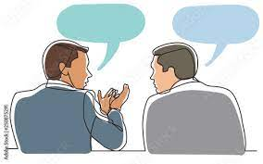
Nuro typical don’t always say what they mean
If want something at a shop instead saying I don’t have in stock the shop keeper will say
“oh they have stopped making it” Or
If we are on trip and I suggest to the driver to take a particular route he will say its not allowed. He could it’s too long I don’t have time. Or he doesn't know the route.
People should just what they mean not cover it half truths because maybe they feel embarrassed.
We neuro-diverjant people don’t think about anyone we respect everyone.

Slide 8
I wish people would say what they mean.
Don’t deny my Autism I don’t am comfortable being neuro-divergent .
I may need a little more clarification then other neuro-typical people.
Neuro-typical people speak too fast so speaking slightly slowly help.
Say what you mean.
Please lets All us communicate and learn about each other.

Slide 9
Thank You

